Slide 1





AIR QUALITY
Predictive Analysis
BDAT 1011 Data Analytics Project
Final Presentation
Submitted by Group 5
© 2024

Slide 2

Table of Content
Project Summary Slide 3
Team Profile Slide 4
Project Introduction Slide 5
Project Technical Workflow Slide 6
Data Collection Slide 7
Data Analysis Slide 10
Modeling Slide 14
Deployment & Data Visualization Slide 20
Project Cost Slide 25
Project Overall Status Slide 28
Results Slide 29
Conclusion Slide 30

Slide 3
Project Summary
Air quality is a critical determinant of public health, and Everyday activities, be it in industries, transportation, or homes, contribute to the introduction of pollutants into our surroundings. This underscores the pressing need for vigilant monitoring and predictive analysis of air quality, particularly in the vibrant and dynamic setting of New York.
the New York State Department of Health has provided a comprehensive dataset spanning from 2005 to 2023, encompassing various parameters related to air quality. The project aims to employ predictive modelling techniques to analyze, forecast, and derive actionable insights from this extensive dataset. By understanding the interplay of factors such as vehicular emissions, industrial processes, and atmospheric conditions, we seek to provide a holistic view of air quality trends in New York City.

Slide 4



Team Profile
Emeka Obinna Okeke
(Team Leader)
Data Scientist
Power BI Data Analyst Associate(Microsoft Certified)
SAS Statistical Business Analyst
Google Data Analytics
Barsha Tamang
(Developer)
Power BI Developer
Project Management Certified
Product Owner and Scrum Master
Hachikaru Anyakwee
(Data Analyst)
Power BI Developer
CompTIA Plus Certified
SAS Statistical Business Analyst Professional Certificate
Google Data Analytics Professional Certificate

Slide 5

Project Introduction
Technical Areas
1
Requirement Phase
Initial Dataset Collection, Dataset Approval, Project Proposal & Charter Approval and Client Approval
2
Design Phase
Data Collection, Data Cleaning, Data Analysis and Aggregation of Dataset
Air Quality
Development Phase
Data Filtration, Data Modeling, Validating Models, Creating Dashboard Prototype, Building Visualization
3
4
Testing Phase
Linear Regression, Predictive Modeling & Final Dashboard Visualization
5
Release Phase
Final Report and Project Close-Out

Slide 6
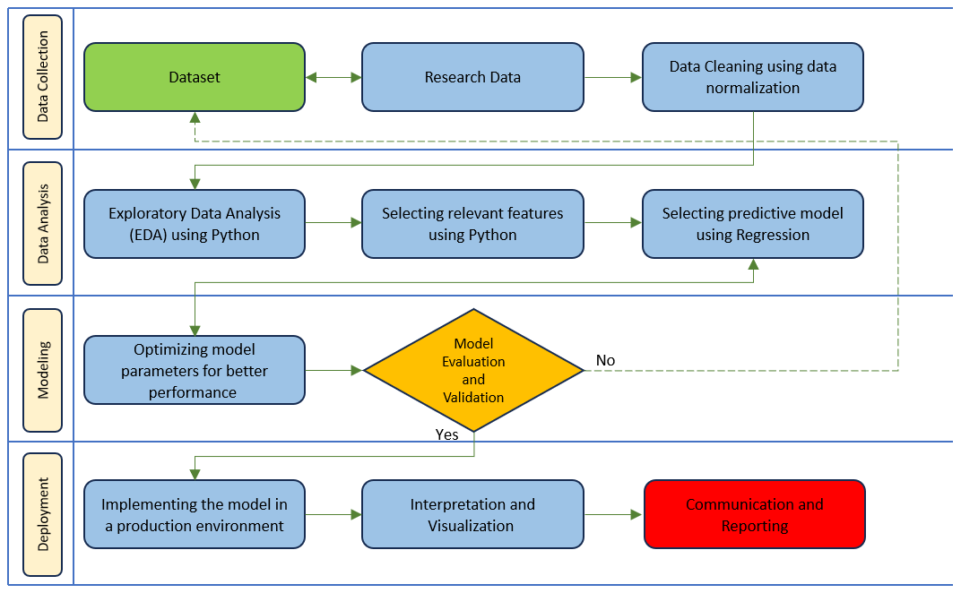

Project Technical Workflow

Slide 7

Data Collection & Cleaning
Downloading dataset and gathering data from various sources.
Geographic data retrieval from air quality monitoring stations.
Data Collection & Cleaning
Cleaning the dataset to remove any inconsistencies, errors, or outliers
Selection of features or variables that could affect air quality.
Combination of data from different sources into a single dataset for analysis.
Transforming and preparing the data for analysis.

Slide 8
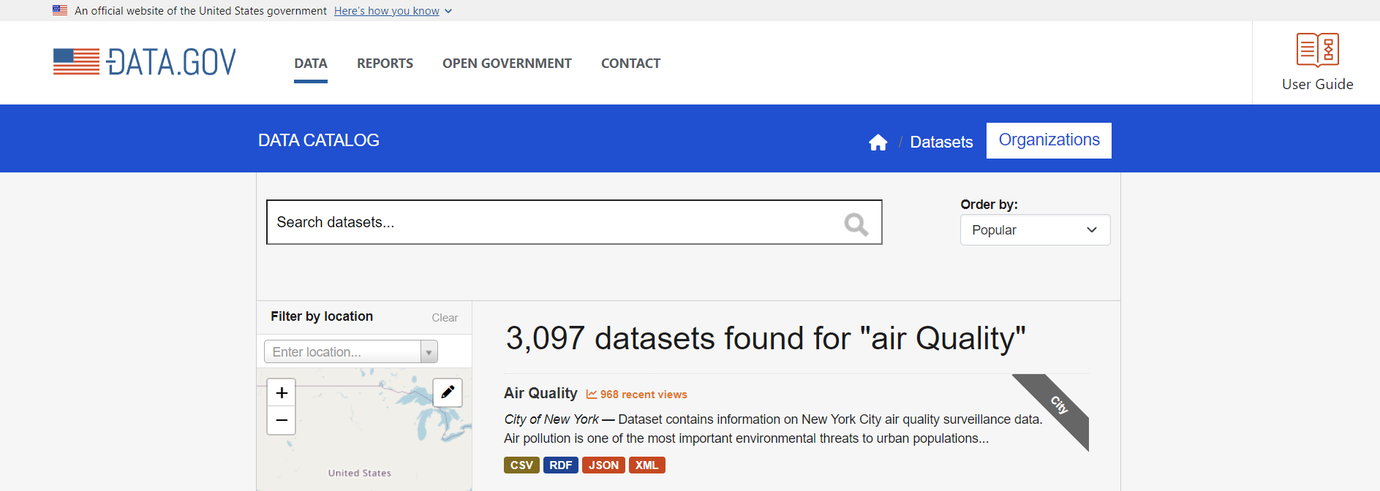
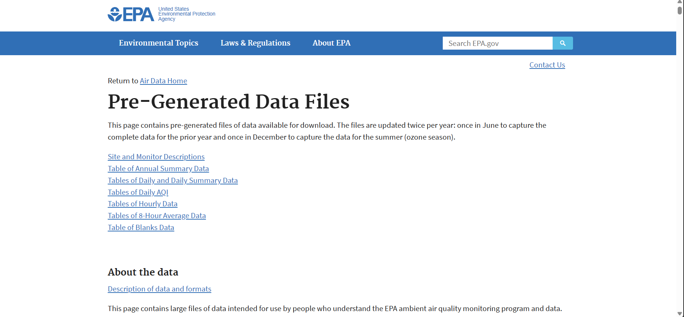
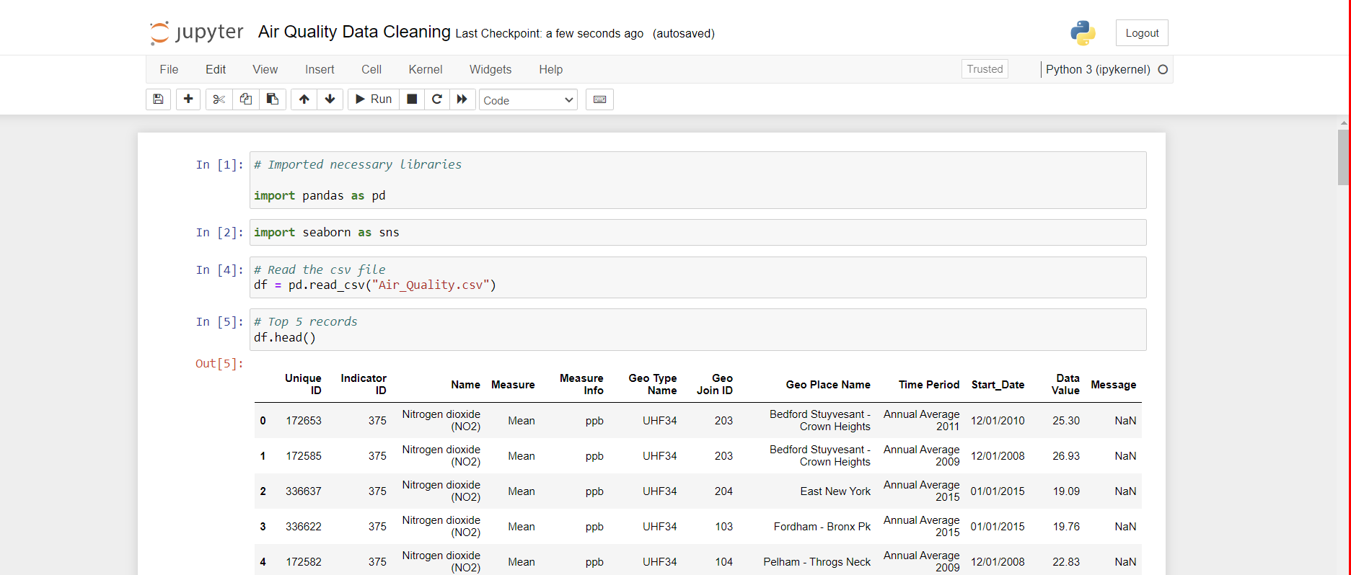
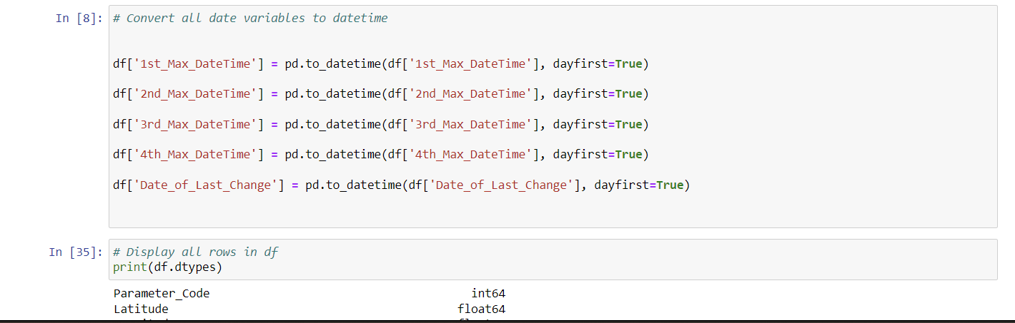
Data Collection & Cleaning
Downloading main dataset
Gathering data from various sources
Loading Dataset for Data Cleaning
Converting data variables to datetime

Slide 9
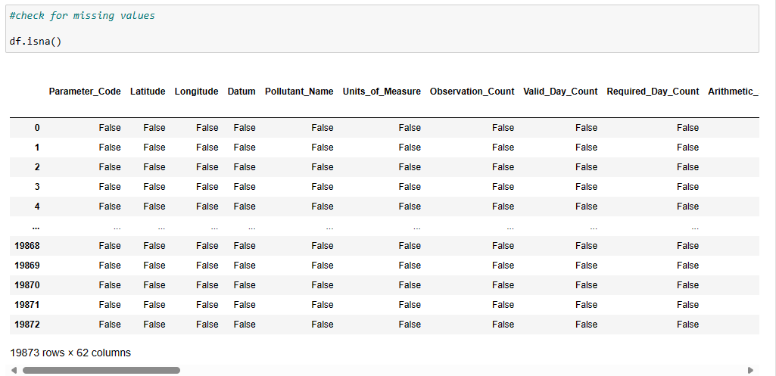
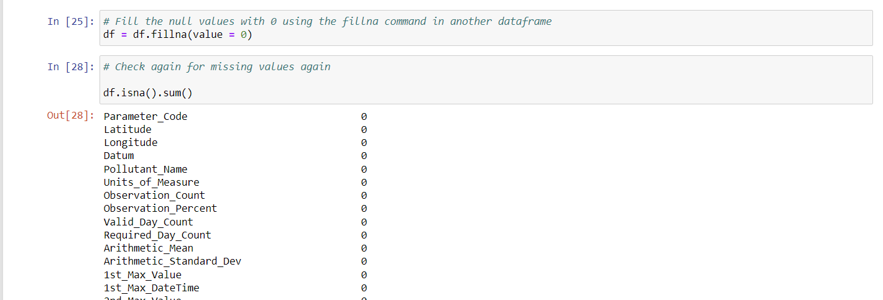
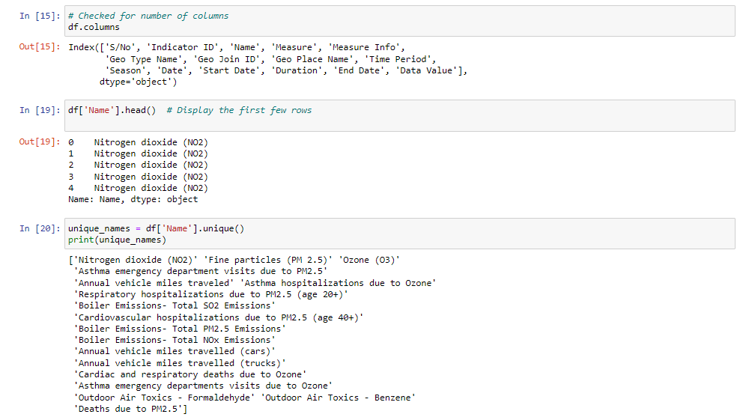
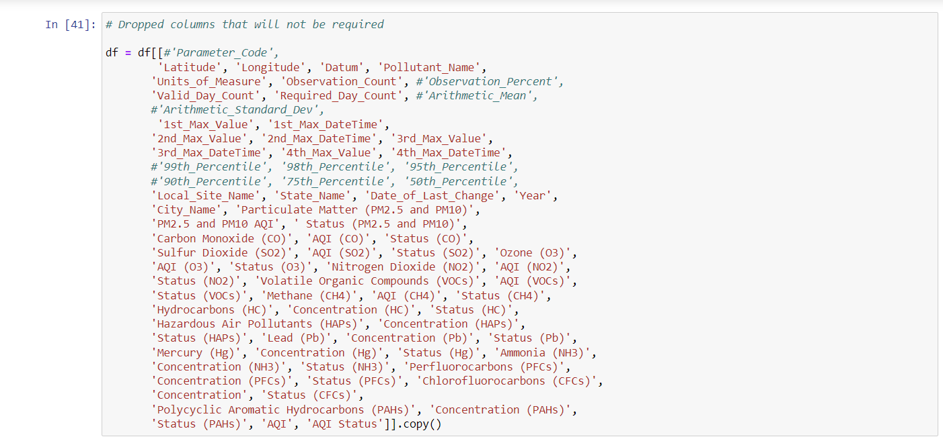
Data Collection & Cleaning
Checking Missing Values
Filling the null values with '0'
Checking for Unique values
Data Cleaning on Jyupter Notebook

Slide 10
Exploratory Data Analysis
Descriptive statistics on the variables
Detection of outlier that deviated significantly from the rest of the data.
Exploratory Data Analysis
Correlation Analysis between variables
Group similar data points based on their characteristics.
Identifying groups or clusters of similar data points based on their characteristics.
Generate charts and visuals to show distributions, relationships, and trends.

Slide 11
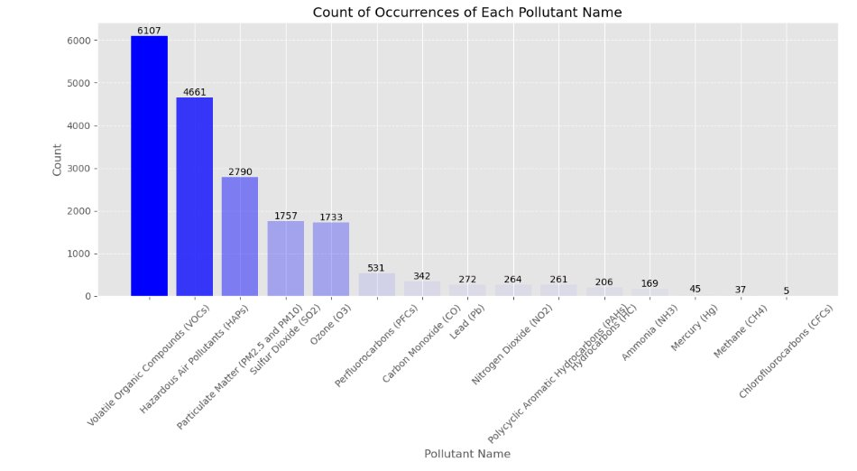
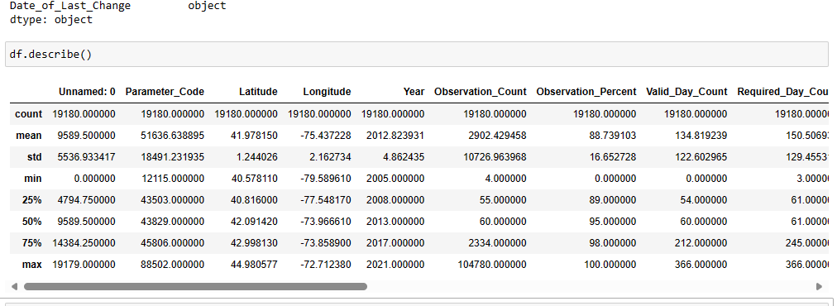
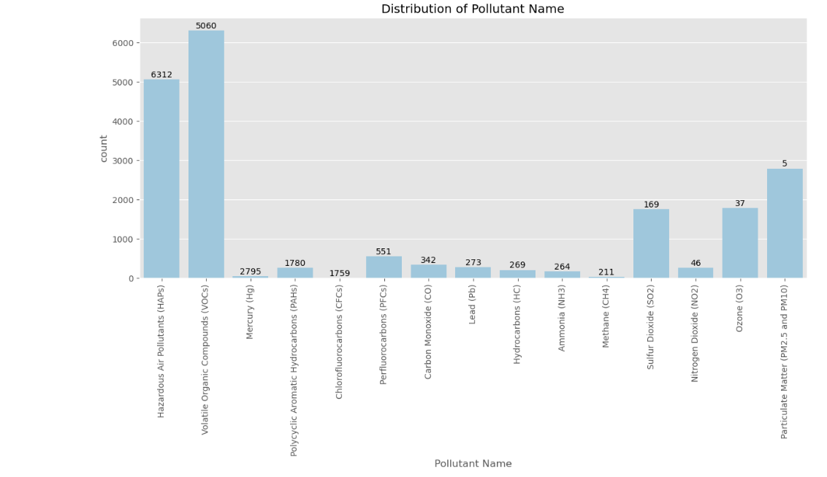
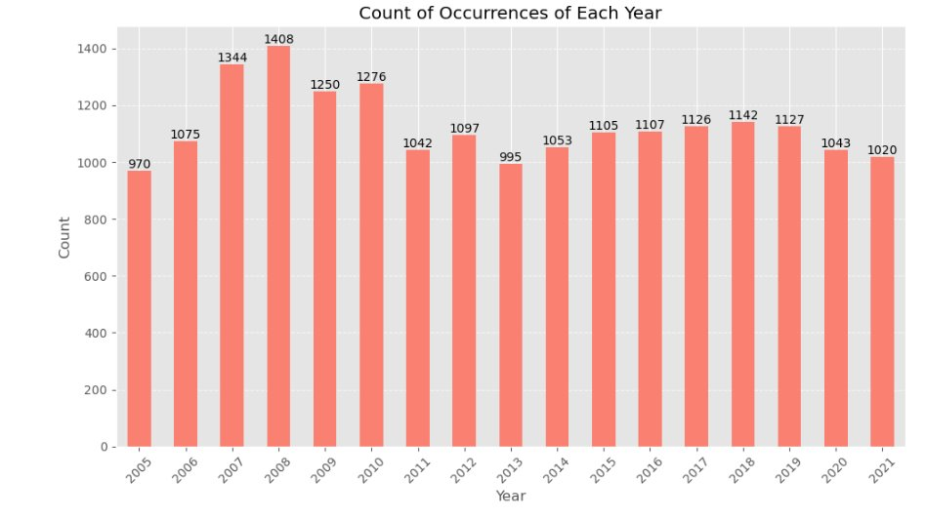
Exploratory Data Analysis
Descriptive statistics on the variables

Slide 12
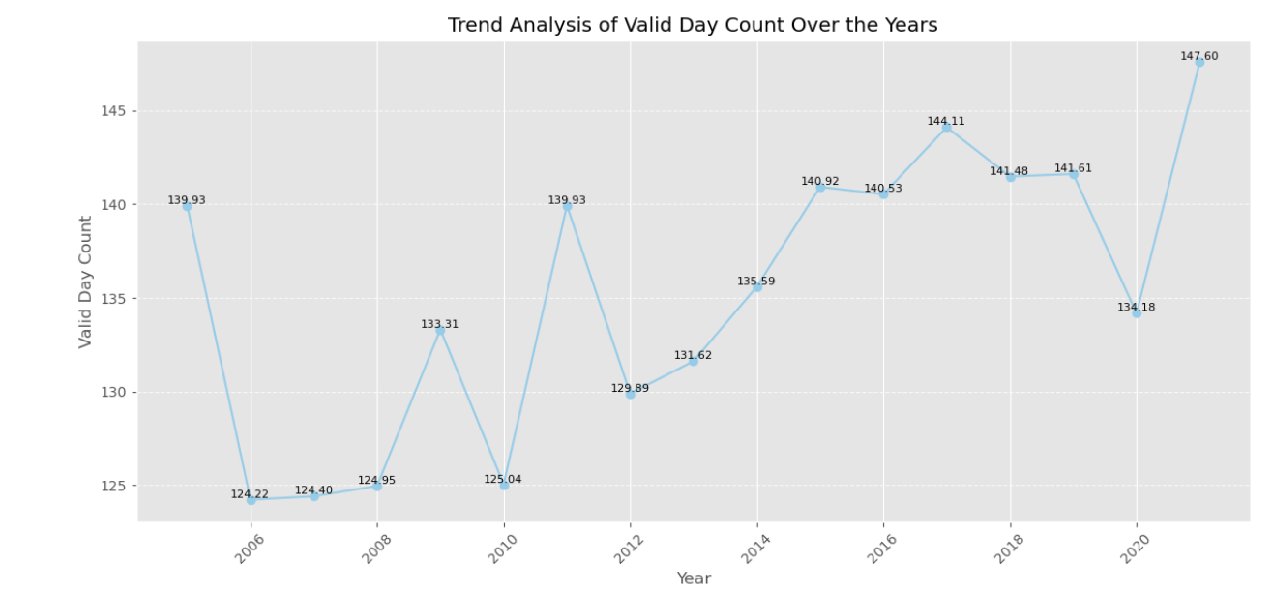
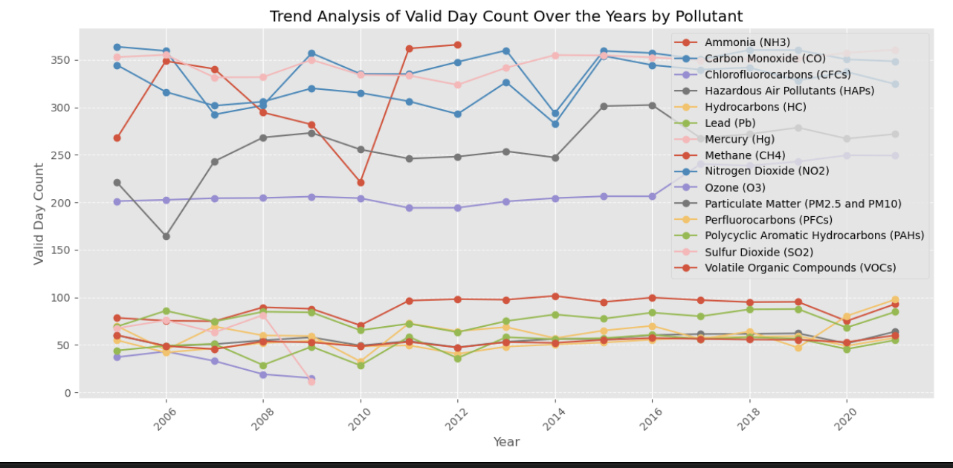
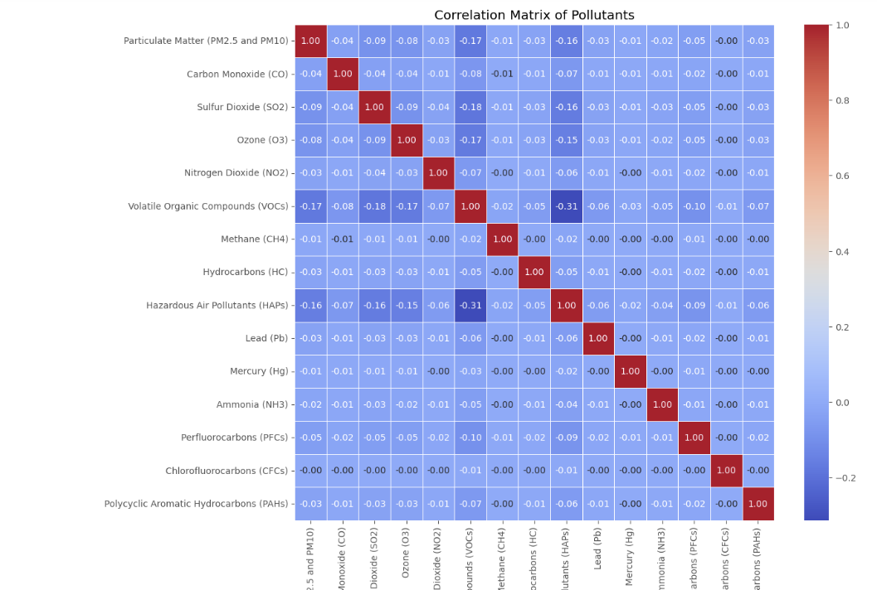
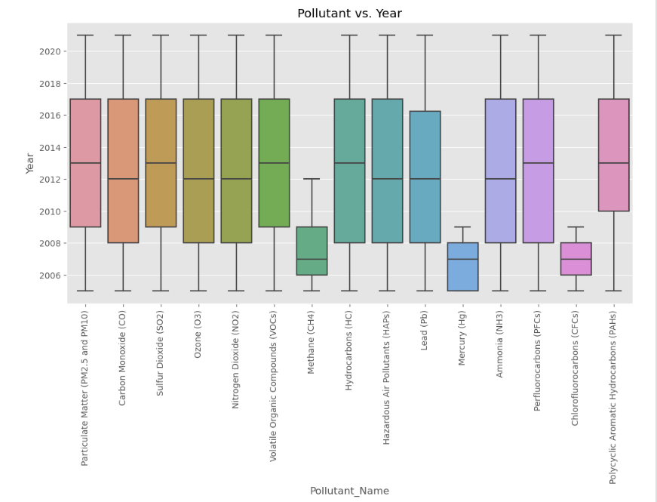
Exploratory Data Analysis

Slide 13
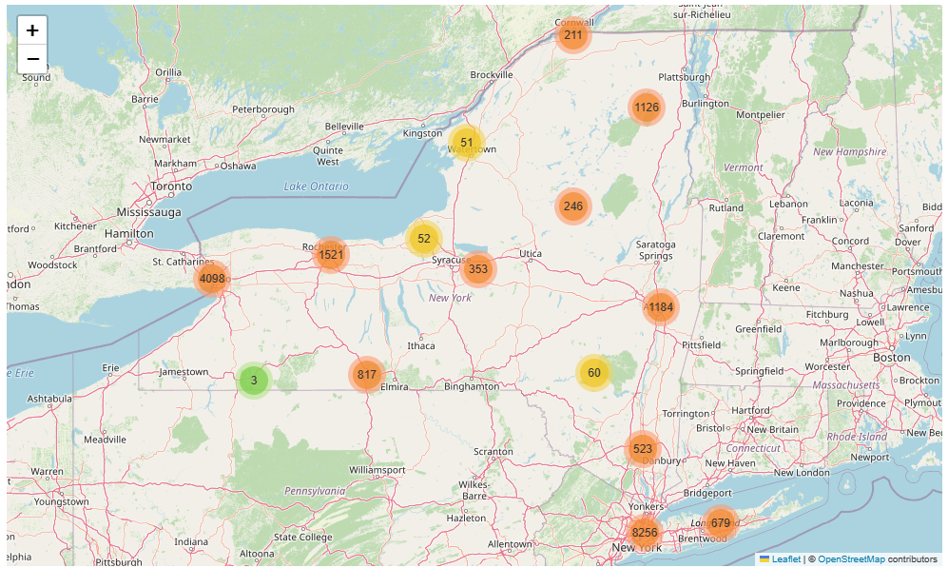
Exploratory Data Analysis
Map showing the distribution of points where data was collected

Slide 14
Data Modeling
Splitting dataset into training and testing sets to evaluate performance
Identification of target variable and the most relevant features.
Data Modeling
Hyperparameter tuning to improve model performance.
Model selection based on the problem type
Model training on the training dataset
Evaluation of trained models on the testing dataset

Slide 15
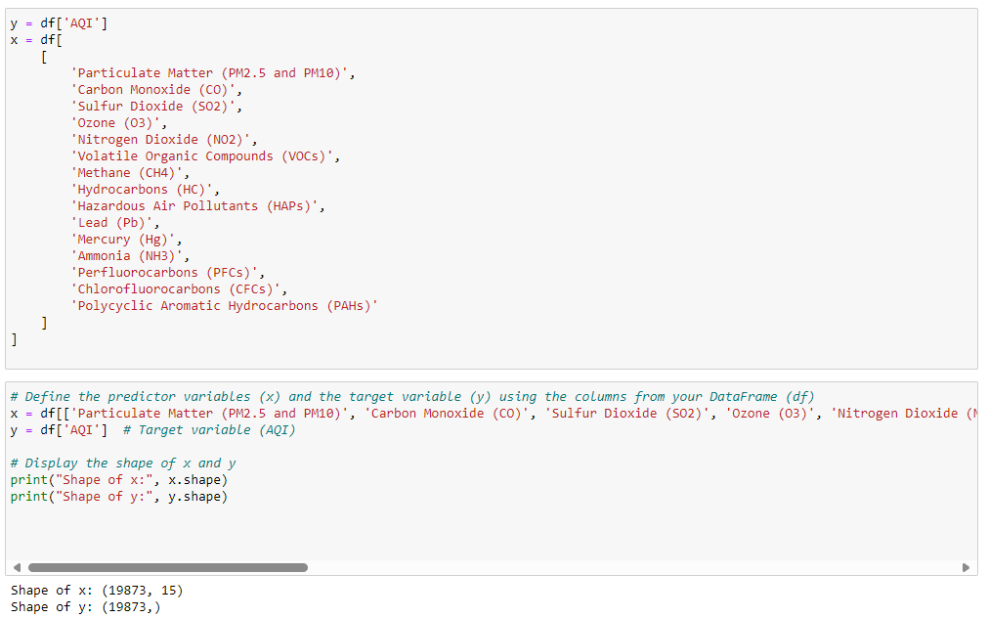
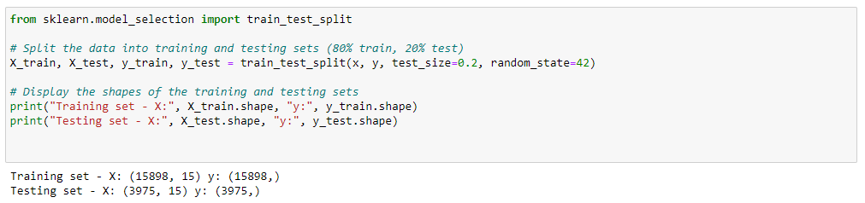
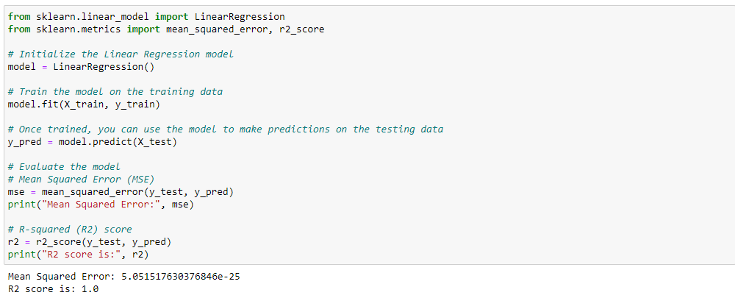
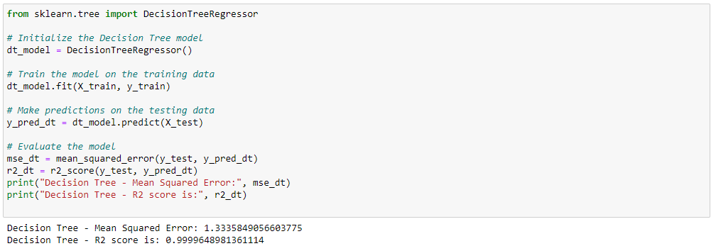
Data Modeling
Defining Predictor Variables
Splitting the Predictor variables into Train and Test
Applied Linear Regression Model
Applied Decision Tree Model

Slide 16
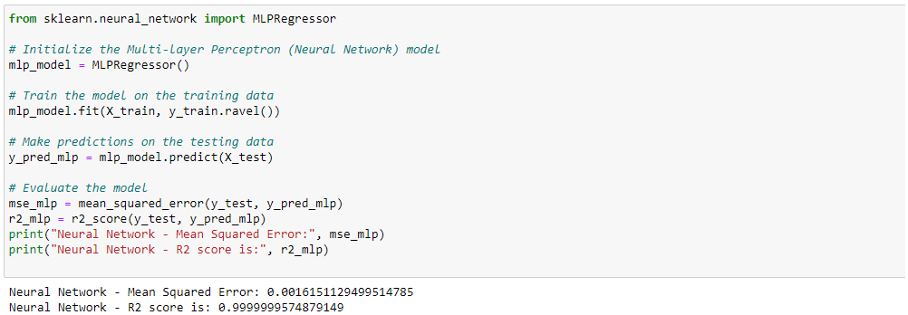
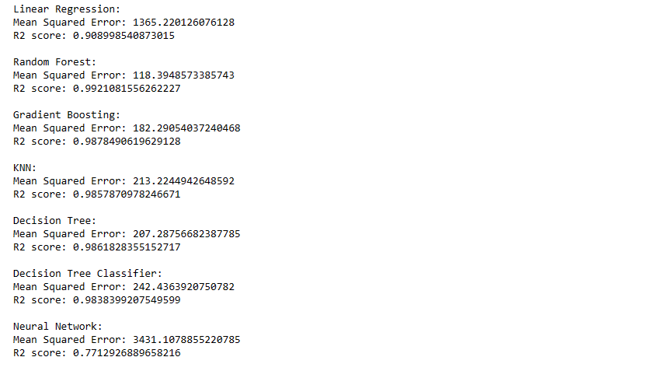
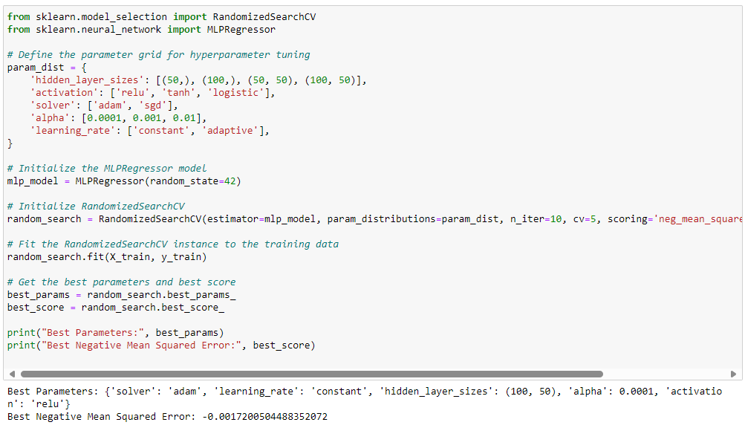
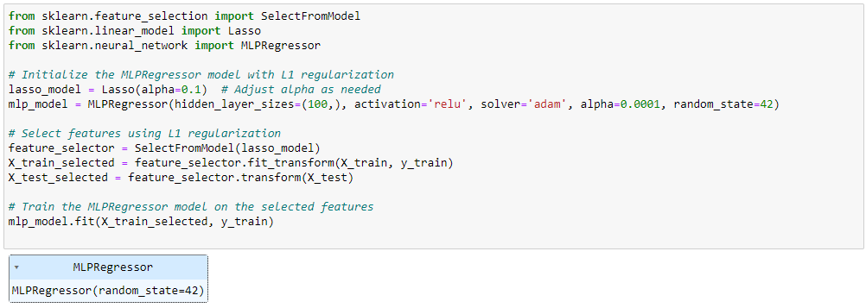
Data Modeling
Comparison between the models
List of all models and their performance
Applied Hyperparameter Tunning to get the best features
Trained the model on the selected best features

Slide 17
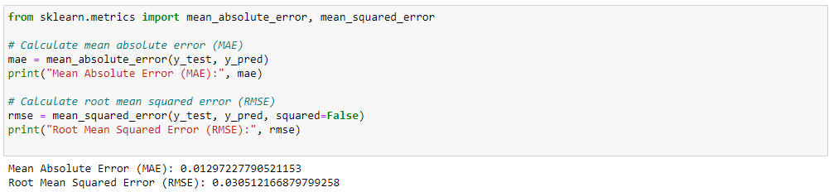
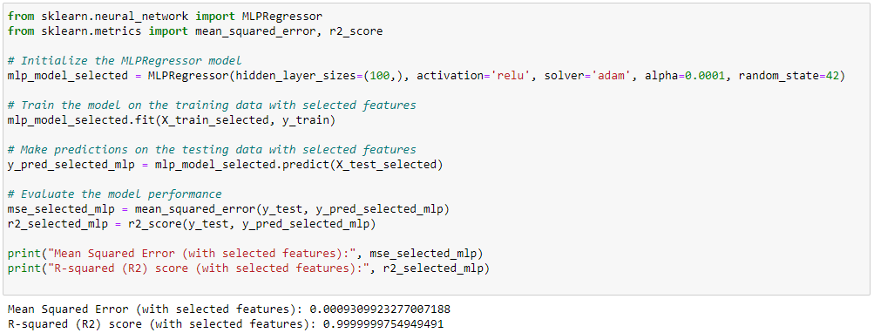
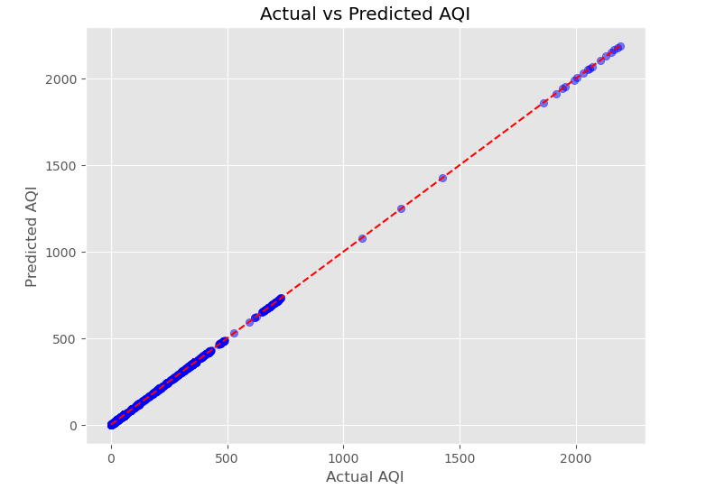
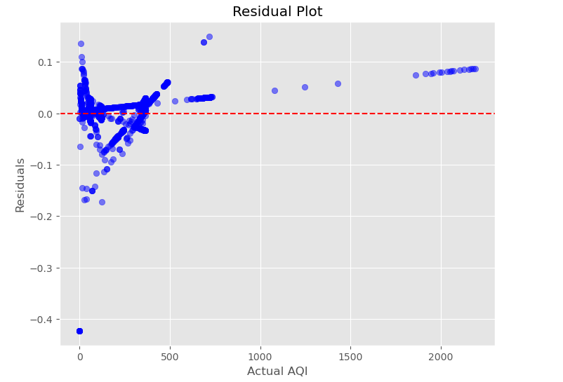
Data Modeling
Model Validation using Mean Absolute (MAE) and RMSE
Model Validation with the selected best features
Scattered Plot showing Actual Vs Predicted Air Quality
Scattered Plot showing Residual Plot

Slide 18
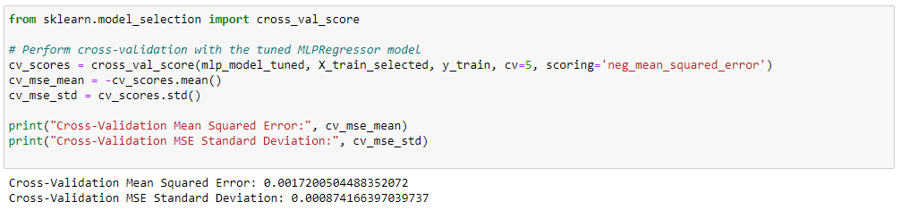
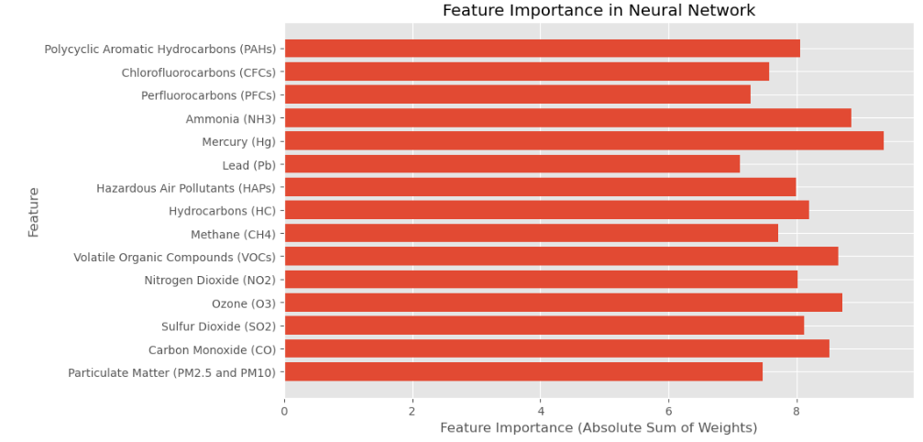
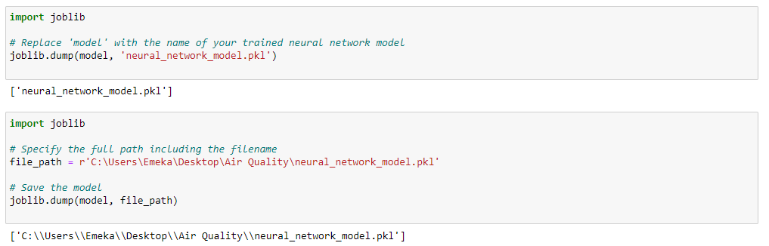
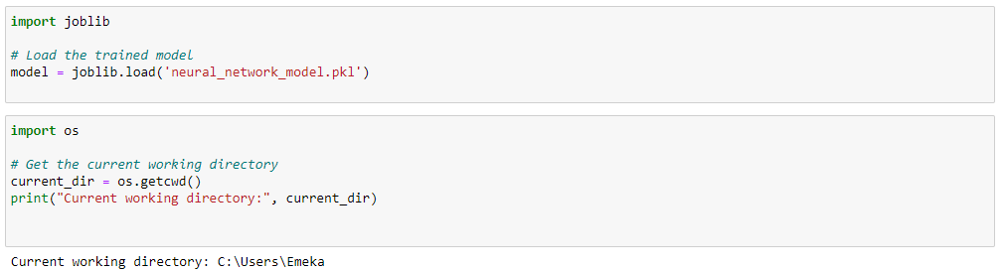
Data Modeling
Cross Validation of the Tuned Model
Chart showing Feature Importance of the selected Model
Saved the model in a location for later use
Loaded the model for sample model testing

Slide 19
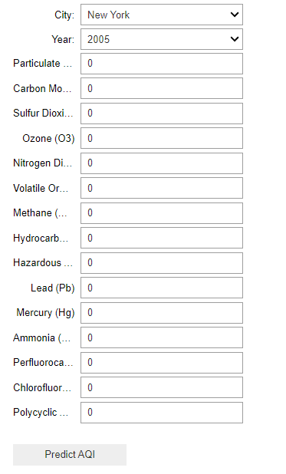
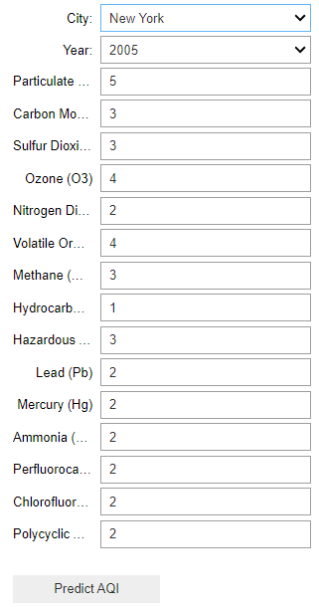
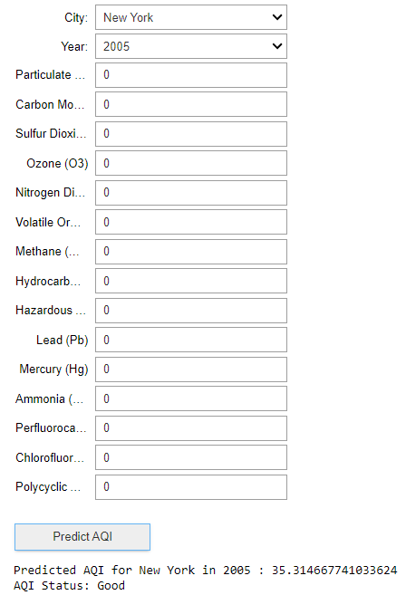
Data Modeling
Before Sample Test
After Sample Test

Slide 20
Data Visualization
Organized the data to fit the star schema's layout of main and related tables.
Created KPIs for improved data visuals.
Built detailed visuals to reveal dataset trends and insights.
Deployment
Applied consistent style and format to all visuals to match the project’s theme.
Sorted visual features by theme and relationship (Dashboard Overview, AQI Insights, GIS Insights).
Added interactive selectors and filters to the dashboard.

Slide 21
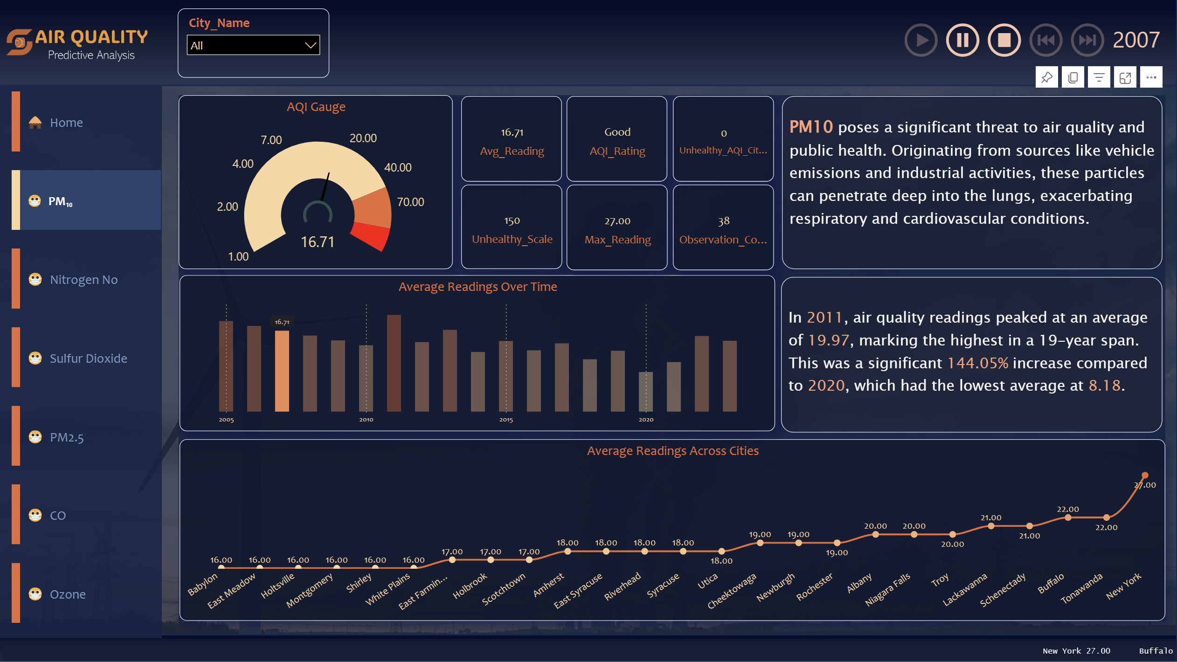
Model Deployment & Visualization
Star Schema Relationship

Slide 22
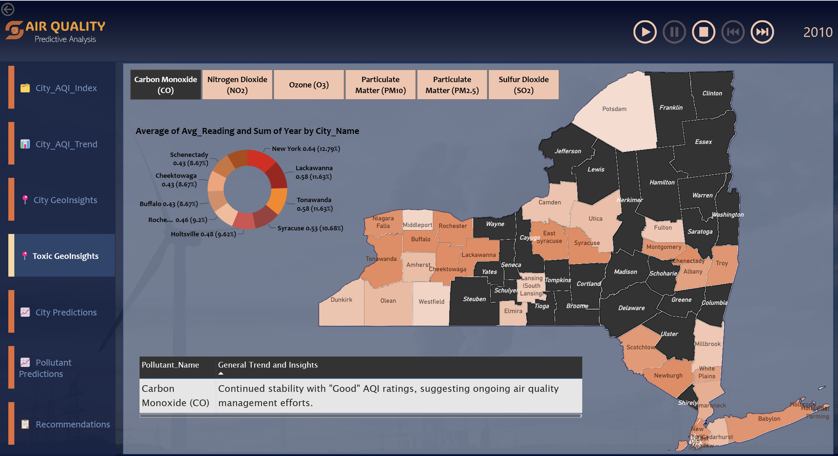
Data Visualization
GIS Insights

Slide 23
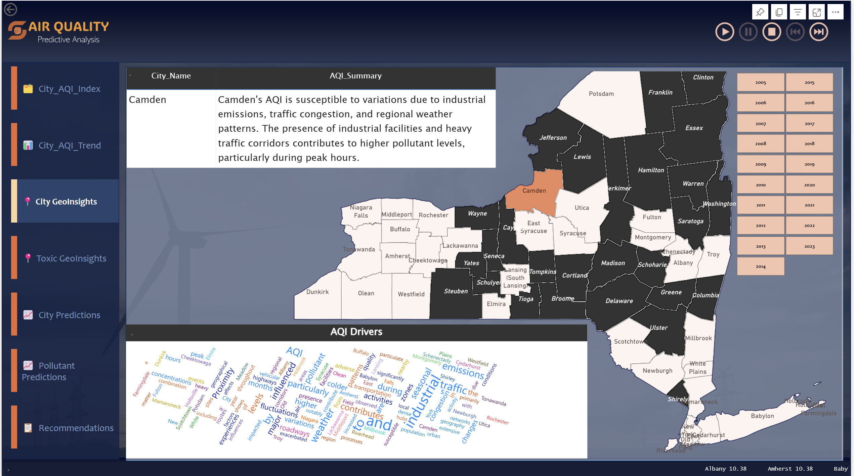
Model Deployment & Visualization
Star Schema Relationship

Slide 24
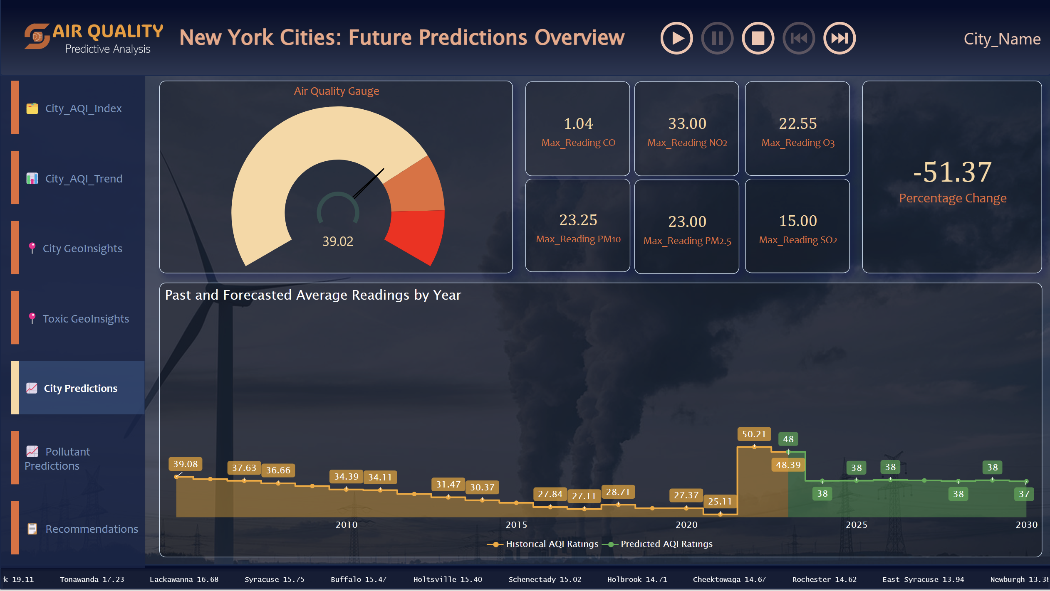
Data Visualization

Slide 25
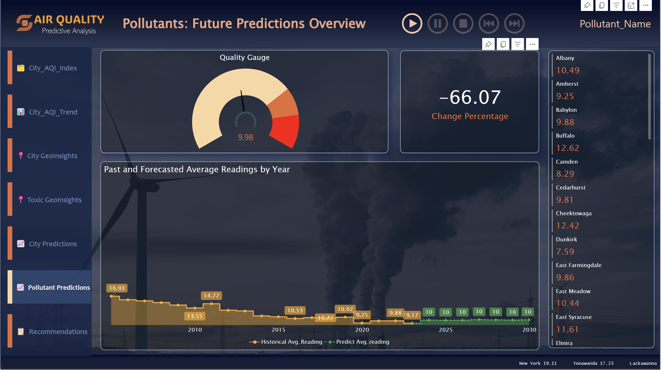
Model Deployment & Visualization
Star Schema Relationship

Slide 26
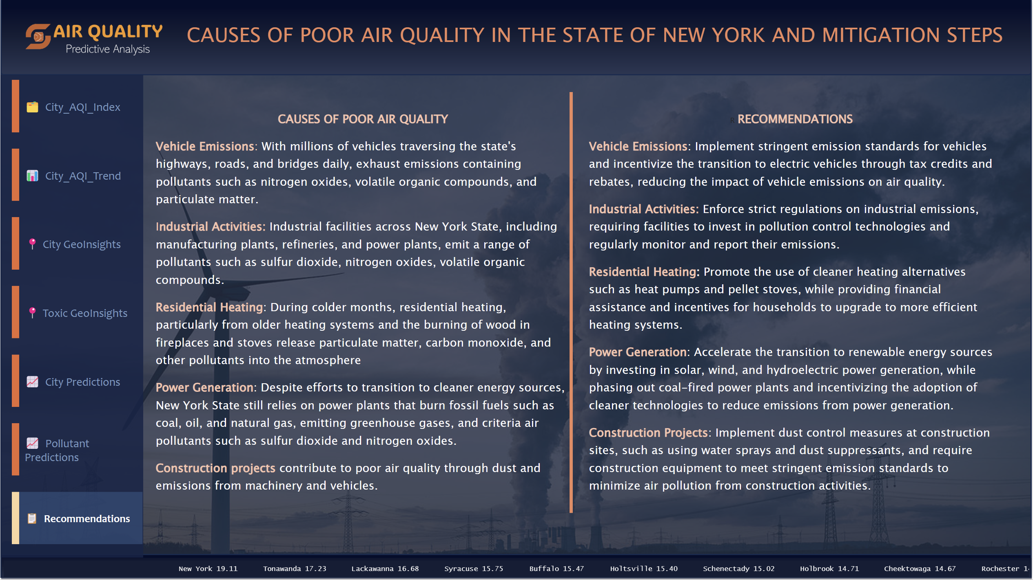
Data Visualization
GIS Insights

Slide 27
Project Cost
Total Budget Cost: $4,300.00
Total Actual Cost: $3,980.00

Slide 28

Project Overall Status
Requirement Phase
Design Phase
Development Phase
Testing Phase
Release Phase
Completed

Slide 29
Results
Identified and addressed missing and inconsistent data, ensuring the integrity of our analysis.
Relevant features were extracted, and temporal patterns and seasonality in air quality parameters were investigated.
Developed models to forecast air quality parameters, visualizing predicted values alongside observed trends.
Analyzed the relationships between air quality parameters and health outcomes over time, quantifying the health impact of different air pollutants.
Provided valuable insights into the trends and patterns of pollutant levels over time.
Generated forecasts for air quality index (AQI) values across different regions and years.
Analyzed various variations in AQI levels among pollutants, with some pollutants exhibiting more pronounced fluctuations over time compared to others.

Slide 30
Conclusion
In conclusion, our predictive analysis project for air quality has yielded valuable insights for the New York State Department of Health. By examining the predictive accuracy of our models, we ascertain its reliability in forecasting AQI values, enabling New York City Department of Health to make informed decisions regarding environmental policies, public health interventions, and urban planning strategies.
As we move forward, it is important to continue refining and validating our model, to enhance the accuracy and reliability of air quality forecasts. Through the application of predictive modeling techniques, we have harnessed the power of extensive datasets to gain insights into the complex interplay of factors influencing air quality, including vehicular emissions, industrial processes, and atmospheric conditions.

Slide 31
THANK YOU

